Slide 1
Reproductive system pathology
By:
dr. yasmeen jasim

Slide 2
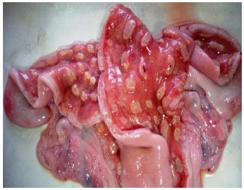
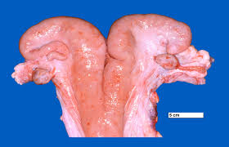
Female reproductive system pathology
Metritis and endometritis (inflammation of the uterus) is caused by bacterial infection. usually is seen following calving. It occurs most commonly after calving's complicated by dystocia, retained fetal membranes, twins or stillbirths.
Symptoms of uterine infections commonly include pain in the lower abdomen or pelvis, fever (usually within 1 to 3 days after delivery), paleness, chills, a general feeling of illness or discomfort, and loss of appetite. The heart rate is often rapid. The uterus is swollen, tender, and soft.

Slide 3
Microscopic features
Histopathology of purulent endometritis hyperplasia and erosion of lining epithelium (small arrow), congestion of blood vessels (largeaarrow) (b) Infiltration of lymphocytes and plasma cells (small arrow), severe periglandular fibrosis (large aarrow), and(c) Complete degeneration of endometrial glands (small arrow)

Slide 4
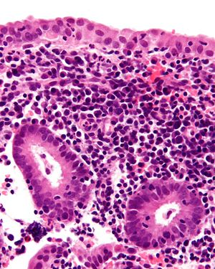
Microscopic features of chronic endometritis
this picture: show chronic endometritis with the characteristic plasma cells. Scattered neutrophils are also present

Slide 5
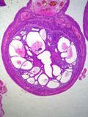
Cystic endometrial hyperplasia
Histological changes in the endometrium with hyperplasia varies from mild to severe. Mild hyperplasia is a thickening of the endometrium with elongation of the glands. As this becomes more greater, the glands become disorganized and rather than straight, become convoluted so that the cross sections vary. The stroma becomes more prominent. There is dilation of the glands with the formation of variably sized cysts.

Slide 6
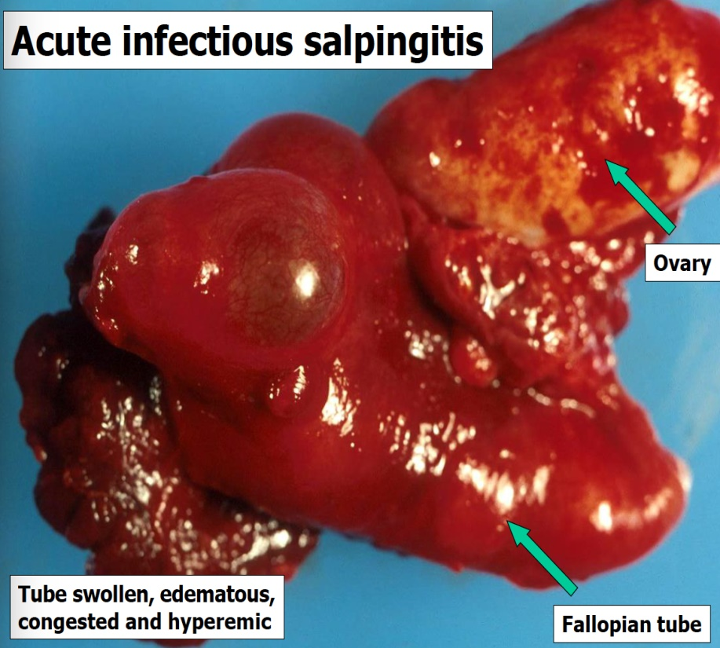
Salpingitis
Salpingitis is defined as an infection and inflammation in the oviducts, Tubal inflammation can be acute or chronic and occurs in mild, moderate or severe grade. It is induced by infection, mostly spreading through the lower tract and ascending into the upper genital tract.

Slide 7
Macroscopic feature
In the bovine, the bacteria associated with genital inflammation are mostly Escherichia coli, Trueperella pyogenes, Trichomoniasis, Campylobacteriosis, Fusobacterium, Staphylococci and Streptococc

Slide 8
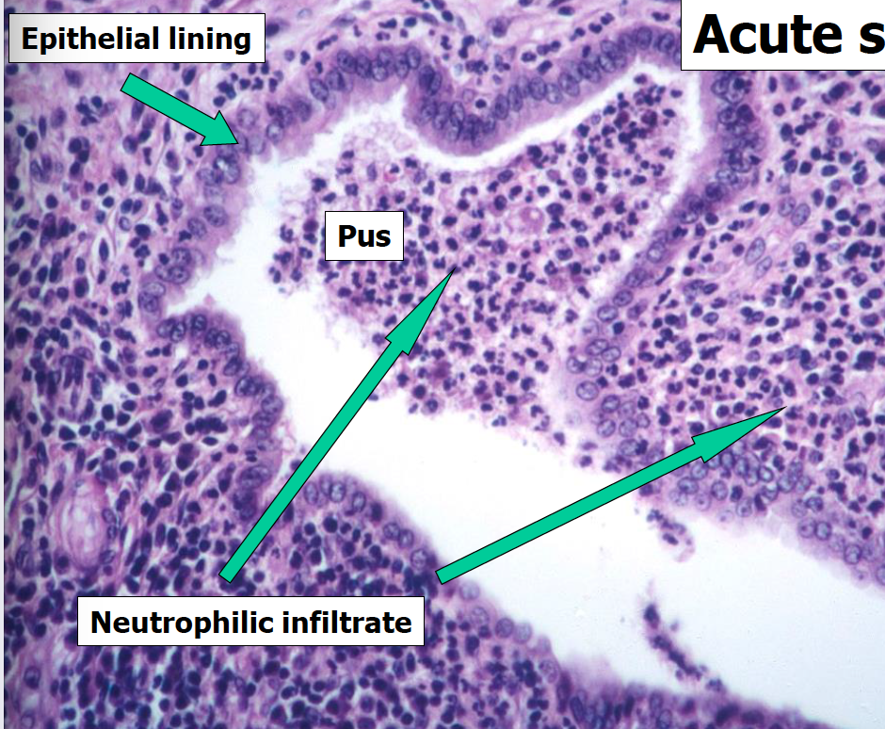
Microscopic features
Acute salpingities :presence of acute inflammatory cells, edema and lymphatic dilation in the tubal plicae are often seen., mucosal ulceration.

Slide 9
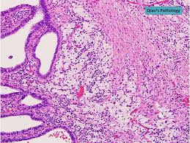
Salpingitis
Microscopic photo showing affected fallopian tube with expanded lamina propria of tubal plicae filled with numerous foamy histiocytes, lymphocytes, plasma cells and neutrophi

Slide 10
cervecitis
the squamo-columnar junction of the cervix
hemorrhage
Small round dark lymphocytes are seen in the submucosa

Slide 11
male reproductive system pathology

Slide 12
Orchitis
Orchitis, inflammation and swelling of the testes as a result of infection or physical injury.

Slide 13
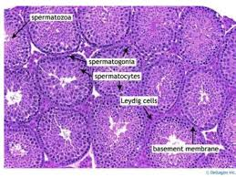
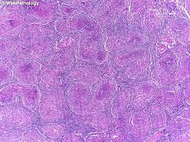
Microscopic features of orchitis
the accumulation of epithelioid histiocytes, lymphocytes, and plasma cells in the seminiferous tubules creates an appearance of granulomas as seen here. In early stages, there may be scattered residual germ cells and Sertoli cells; however, in late stages, there is complete destruction of tubular architecture and atrophy with fibrosis

Slide 14
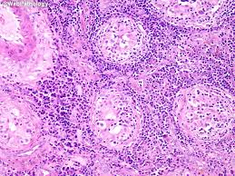
Microscopic features of orchitis
The seminiferous tubules contain residual germ cells and Sertoli cells; however, there is no evidence of spermatogenesis. The inflammatory infiltrate is mixed consisting predominantly of lymphocytes, plasma cells, and histiocytes along with neutrophils.

Slide 15
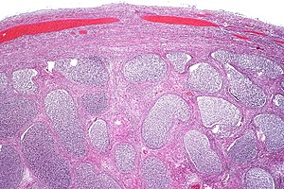
Epididymitis
Epididymitis is a medical condition characterized by inflammation of the epididymis, a curved structure at the back of the testicle. Onset of pain is typically over a day or two. The pain may improve with raising the testicle. Other symptoms may include swelling of the testicle, burning with urination, or frequent urination. Inflammation of the testicle is commonly also present
Acute epididymitis with abundant fibrinopurulent exudate in the tubules

Slide 16
Thank you

